Slide 1
Structured Programming Language
Nahidul Islam
Lecturer, Dept. of CSE
DCC, Dhaka.
1/31/2023
1

Slide 2
Constants
Constants
Numeric Constants
Character Constants
integer
floating-point
single character
string
2

Slide 3
Integer Constants
Consists of a sequence of digits, with possibly a plus or a minus sign before it.
– Embedded spaces, commas and non-digit characters are not permitted between digits.
Maximum and minimum values (for 32-bit representations)
Maximum :: Minimum ::
2147483647
– 2147483648
3

Slide 4
Floating-point Constants
Can contain fractional parts.
Very large or very small numbers can be represented. 23000000 can be represented as 2.3e7
e means “10 to the power of”
Two different notations:
Decimal notation
25.0, 0.0034, .84, -2.234
Exponential (scientific) notation
3.45e23, 0.123e-12, 123E2
4

Slide 5
Single Character Constants
Contains a single character enclosed within a pair of single quote marks.
– Examples :: ‘2’, ‘+’, ‘Z’
Some special backslash characters ‘\n’ new line
‘\t’ ‘\’’
horizontal tab single quote
‘\”’ double quote ‘\\’ backslash ‘\0’ null
5

Slide 6
String Constants
Sequence of characters enclosed in double quotes.
– The characters may be letters, numbers, special characters and blank spaces.
Examples:
“nice”, “Good Morning”, “3+6”, “3”, “C”
6

Slide 7
Escape Sequences
There are certain characters in C when they are preceded by a backslash they will have special meaning.
Sequence Meaning
\a Bell (alert)
\b Backspace
\n Newline
\t Horizontal tab
\\ Backslash
\' Single quote
\" Double quotation
\xhh ASCII char specified by hex digits hh
\ooo ASCII char specified by octal digits ooo
7

Slide 8
Example: Constant (The const keyword)
Syntax: const type variable = value;
#include<stdio.h>
int main(){
const float PI=3.14;
printf("The value of PI is: %f",PI);
return 0; 6.}
Output:
The value of PI is: 3.140000
8

Slide 9
Example: Constant (The const keyword)
If you try to change the value of PI, it will render compile time error.
#include<stdio.h>
int main(){
const float PI=3.14; 4. PI=4.5;
printf("The value of PI is: %f",PI);
return 0; 7.}
Output:
Compile Time Error: Cannot modify a const object
9

Slide 10
Declaration of Variables
There are two purposes:
It tells the compiler what the variable name is.
It specifies what type of data the variable will hold.
Syntax:
data-type variable_1, variable_2,……..,variable_n;
•
Examples:
int velocity, distance; int a, b, c, d;
float temp;
char flag, option;
10

Slide 11
An Example : Variable Declaration
#include <stdio.h> main()
{
float speed, time, distance;
Variable declaration
scanf (“%f %f”, &speed, &time); distance = speed * time;
printf (“\n The distance traversed is: %f”, distance);
}
11

Slide 12
Expression
An expression represents a single data item, such as a number or a character. The expression may consist of a single entity, such as a constant, a variable, an array element or a reference to a function. It may also consist of some combination of such entities, interconnected by one or more operators.
Several simple expressions are shown below.
a + b x = y
c = a + b x <= y
x == Y
++i
12

Slide 13
Statement
A statement causes the computer to carry out some action. There are three different classes of statements in C.
They are expression statements, compound statements and control statements.
Expression Statement:
An expression statement
consists of an expression
followed by a semicolon.
a = 3;
c = a + b ;
++i;
// Assignment statement
// Assignment statement
// Incremental statement
p r i n t f ("Area = %f”, area);

Slide 14
Statement (Cont..)
Compound Statement:
A compound statement consists of several individual statements enclosed within a pair of braces { }.
A typical compound statement is shown below.
{
p i = 3.141593;
circumference = 2 * pi * radius; area = pi * radius * radius;
}

Slide 15
Statement (Cont..)
Control Statement:
Control statements are used to create special program features, such as logical tests, loops and branches.
Example:
while (count <= n) {
printf ( ' x = ' ) ;
scanf ( “%f" , &x) ; sum += x;
++count;
}

Slide 16
Operators
Operators
Arithmetic Operators
Relational Operators
Logical Operators
Bitwise Operators

Slide 17
Arithmetic Operators
Addition ::
Subtraction :: –
Division ::
Multiplication :: *
Modulus :: %
+
/
Examples:
distance = rate * time ; netIncome = income - tax ; speed = distance / time ; area = PI * radius * radius; y = a * x * x + b*x + c;
quotient = dividend / divisor; remain =dividend % divisor;
17

Slide 18
Arithmetic Operators(Cont..)
Suppose x and y are two integer variables, whose values are 13 and 5 respectively.
x + y | 18
x – y | 8
x * y | 65
x / y | 2
x % y | 3
18

Slide 19
Operator Precedence
In decreasing order of priority
Parentheses :: ( )
Unary minus :: –5
Multiplication, Division, and Modulus
Addition and Subtraction
For operators of the same priority, evaluation is from
left to right as they appear.
Parenthesis may be used to change the precedence of
operator evaluation.
19

Slide 20
Examples: Arithmetic expressions
a + b * c – d / e a * – b + d % e – f a – b + c + d | ? ? ? | a + (b * c) – (d / e) a * (– b) + (d % e) – f (((a – b) + c) + d)
x * y * z | ? | ((x * y) * z)
a + b + c * d * e | ? | (a + b) + ((c * d) * e)

Slide 21
Type Cast
The value of an expression can be converted to a different data type if desired.
To do so, the expression must be preceded by the name of the desired data type, enclosed in parentheses, i.e.,
(data type) expression.
Example:
int x=10;
float y,z=3.14; y=(float) x; x=(int) z; x=(int) (-z);
/* y=10.0 */
/* x=3
/* x=-3
*/
-- rounded approaching zero */

Slide 22
Relational Operators
Used to compare two quantities.
< is less than
> is greater than
<= is less than or equal to
>= is greater than or equal to
== is equal to
!= is not equal to

Slide 23
Relational Operators: Examples
10 > 20
25 < 35.5
12 > (7 + 5)
is false is true is false
When arithmetic expressions are used on either side of a relational operator, the arithmetic expressions will be evaluated first and then the results compared.
a + b > c – d is the same as (a+b) > (c+d)

Slide 24
Relational Operators: Examples
Sample code segment in C
if (x > y)
printf (“%d is larger\n”, x); else
printf (“%d is larger\n”, y);

Slide 25
Logical Operators
There are two logical operators in C (also called logical connectives).
&& ? Logical AND
| | ? Logical OR
What they do?
They act upon operands that are themselves logical expressions.
The individual logical expressions get combined into more complex conditions that are true or false.

Slide 26
Logical Operators (Cont..)
Logical AND
Result is true if both the operands are true.
Logical OR
Result is true if at least one of the operands are true.
X | Y | X && Y | X | | Y
FALSE | FALSE | FALSE | FALSE
FALSE | TRUE | FALSE | TRUE
TRUE | FALSE | FALSE | TRUE
TRUE | TRUE | TRUE | TRUE

Slide 27
Bitwise Operators
The bitwise operators are the operators used to perform the operations on the data at the bit-level.
Operator | Meaning of operator
& | Bitwise AND operator
| | Bitwise OR operator
^ | Bitwise exclusive OR operator
~ | One's complement operator (unary operator)
<< | Left shift operator
>> | Right shift operator

Slide 28
Bitwise Operators
Truth table of bitwise operators
X | Y | X&Y | X|Y | X^Y
0 | 0 | 0 | 0 | 0
0 | 1 | 0 | 1 | 1
1 | 0 | 0 | 1 | 1
1 | 1 | 1 | 1 | 0

Slide 29
Bitwise AND
For example:
We have two variables a and b. a =6;
b=4;
The binary representation of the
#include <stdio.h>
int main() 3.{
int a=6, b=4; // variable
printf("The output is %d",a&b);
return 0;
above two variables are given below _{6.}
:
a = 0110
b = 0100
7.}
Output: The output is 4
a&b = 0100

Slide 30
Bitwise AND
Bitwise AND is a binary operator (operates on two operands). It's denoted by &.
The & operator compares corresponding bits of two operands. If both bits are 1, it gives 1. If either of the bits is not 1, it gives 0.
For example,
12 | = | 00001100 | (In | Binary)
25 | = | 00011001 | (In | Binary)
Bit | Operation |  | of | 12 | and | 25
00001100
& 00011001
00001000 = 8 (In decimal)

Slide 31
Bitwise OR
For example:
We consider two variables, a = 23;
b = 10;
The binary representation of the above two variables would be:
#include <stdio.h>
int main() 3.{
int a=23,b=10; // variable
printf("The output is %d",a|b);
return 0; 7.}
Output: The output is 31
a = | 00010111
b = | 00001010
a|b = | 00011111

Slide 32
Bitwise OR
Bitwise OR is a binary operator (operates on two operands). It's denoted by |.
The | operator compares corresponding bits of two operands. If either of the bits is 1, it gives 1. If not, it gives 0. For example,
12 | = | 00001100 | (In | Binary)
25 | = | 00011001 | (In | Binary)
Bitwise OR Operation of 12 and 25 00001100
| 00011001
00011101 = 29 (In decimal)

Slide 33
Bitwise XOR
For example:
We consider two variables a and b,
a = 12;
b = 10;
The binary representation of the above two variables would be:
a = 00001100
b = 00001010
(a^b) = 0000 1110
#include <stdio.h>
int main() 3.{
int a=12,b=10; // variable
printf("The output is %d",a^b);
return 0; 7.}
Output: The output is 6

Slide 34
Bitwise XOR
Bitwise XOR is a binary operator (operates on two operands). It's denoted by ^.
The ^ operator compares corresponding bits of two operands. If corresponding bits are different, it gives 1. If corresponding bits are same, it gives 0.
For example,
Bitwise XOR Operation of 12 and 25 00001100
^ 00011001
00010101 = 21 (In decimal)
12 | = | 00001100 | (In | Binary)
25 | = | 00011001 | (In | Binary)

Slide 35
Bitwise Complement
Bitwise complement is an unary operator (works on only one operand). It is denoted by ~.
The ~ operator inverts the bit pattern. It makes every 0 to 1, and every 1 to 0.
35 = 00100011 (In Binary)
Bitwise complement Operation of 35
~ 00100011
11011100 = 220 (In decimal)

Slide 36
Bitwise Complement
#include <stdio.h>
int main() 3.{
int a= 35; // variable
printf("The output is %d",~a);
return 0; 7.}
Output: The output is -36
Why are we getting output -36 instead of 220?
It's because the compiler is showing 2's complement number; negative notation of the binary number.
of that

Slide 37
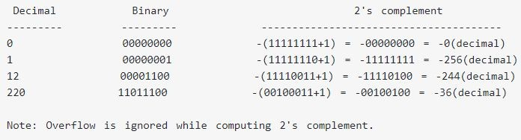
Bitwise Complement
For any integer n, 2's complement of n will be -(n+1).
The bitwise complement of 35 is 220 (in decimal). The 2's complement of 220 is -36. Hence, the output is -36 instead of 220.

Slide 38
left shift, right shift
A= 00111100
<< (left shift)
Binary Left Shift Operator. The left operands value is moved left by the number of bits specified by the right operand
Example: A << 2 will give 240 which is 1111 0000.
>> (right shift)
Binary Right Shift Operator. The left operands value is moved right by the number of bits specified by the right operand.
Example: A >> 2 will give 15 which is 1111

Slide 39
left shift, right shift
#include <stdio.h>
int main() 3.{
int a=5; // variable declaration
printf("The value of a<<2 is : %d ", a<<2);
return 0; 7.}
#include <stdio.h>
int main() 3.{
char b = ‘A’; // variable declaration
printf("The value of A<<2 is : %d ", A<<2);
return 0; 7.}

Slide 40
Other Operators
Some unary operators: -, ++, --, ! Example : ++a, --b
C contains the following five additional assignment operators:
+=, -= , *=, /= and %=.
To see how they are used, consider the first operator, +=. The assignment expression
expression 1 += expression 2
is equivalent to
expression 1 = expression 1 + expression 2
Similarly, the assignment expression
expression I -= expression 2
is equivalent to
expression 1 = expression I - expression 2
and so on for all five operators.

Slide 41
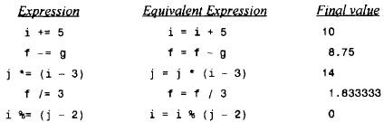
Other Operators
Suppose that i and j are integer variables whose values are 5 and 7, and f and g are floating-point variables whose values are 5.5 and -3.25.

Slide 42
Increment and Decrement Operators
// Working of increment and decrement operators #include <stdio.h>
int main()
{
int a = 10, b = 100;
float c = 10.5, d = 100.5;
Output: ++a = 11
--b | = | 99
++c | = | 11.500000
--d | = | 99.500000
 | printf("++a | = | %d | \n", | ++a);
 | printf("--b | = | %d | \n", | --b);
 | printf("++c | = | %f | \n", | ++c);
 | printf("--d | = | %f | \n", | --d);
} | return 0;
42

Slide 43
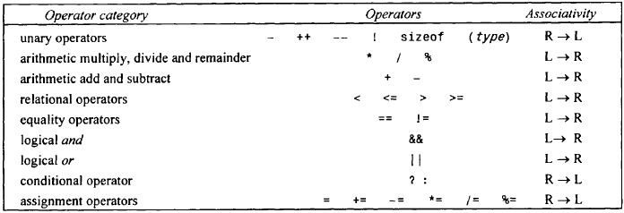
Operator Precedence Groups
43

Slide 44
Operator Precedence in C
#include <stdio.h> main()
{ int a = 20; int b = 10; int c = 15; int d = 5; int e;
e = (a + b) * c / d; // ( 30 * 15 ) / 5 printf("Value of (a + b) * c / d is : %d\n", e );
e = ((a + b) * c) / d; | // | (30 * 15 ) / 5
printf("Value of ((a + | b) | * c) / d is : %d\n" , e );
e = (a + b) * (c / d); | // | (30) * (15/5)
printf("Value of (a + b) * (c / d) is : %d\n", e );
e = a + (b * c) / d; // 20 + (150/5)
printf("Value of a + (b * c) / d is : %d\n" , e ); return 0;
}
44

Slide 45
Operator Precedence in C
Output:
Value of (a + b) * c / d is : 90 Value of ((a + b) * c) / d is : 90 Value of (a + b) * (c / d) is : 90 Value of a + (b * c) / d is : 50

Slide 46
Library function
The C language is accompanied by a number of library functions that carry out various commonly used operations or calculations.
A library function is accessed simply by writing the function name, followed by a list of arguments that represent information being passed to the function.

Slide 47
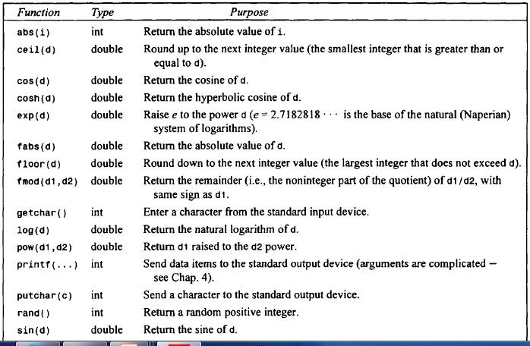
Library function (Cont..)
Some commonly used library function

Slide 48
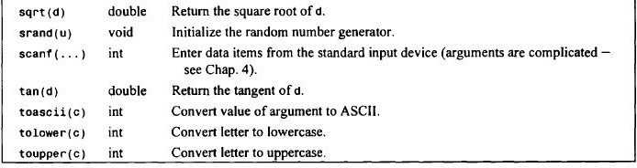
Library function (Cont..)

Slide 49
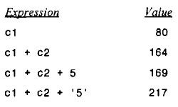
suppose that c1 and c2 are character-type variables that represent the characters P and T, respectively. Several arithmetic expressions that make use of these variables are shown below, together with their resulting values (based upon the ASCII character set).
Note that P is encoded as (decimal) 80, T is encoded as 84, and 5 is encoded as 53 in the ASCII character set

Slide 50
Comments in C
Comments in C language are used to provide information about lines of code. It is widely used for documenting code. There are 2 types of comments in the C language.
Single Line Comments
Multi-Line Comments
Single Line Comments
Single line comments are represented by double slash //.
#include<stdio.h>
int main(){
//printing information
printf("Hello C");
return 0;
6.}
50

Slide 51
Comments in C
Mult Line Comments
Multi-Line comments are represented by slash asterisk \*
... *\. It can occupy many lines of code, but it can't be nested. Syntax:
/*
code
to be commented
*/
#include<stdio.h>
int main(){
/*printing information
Multi-Line Comment*/
printf("Hello C");
return 0;
7.}

Slide 52
Thank You

